Slide 1
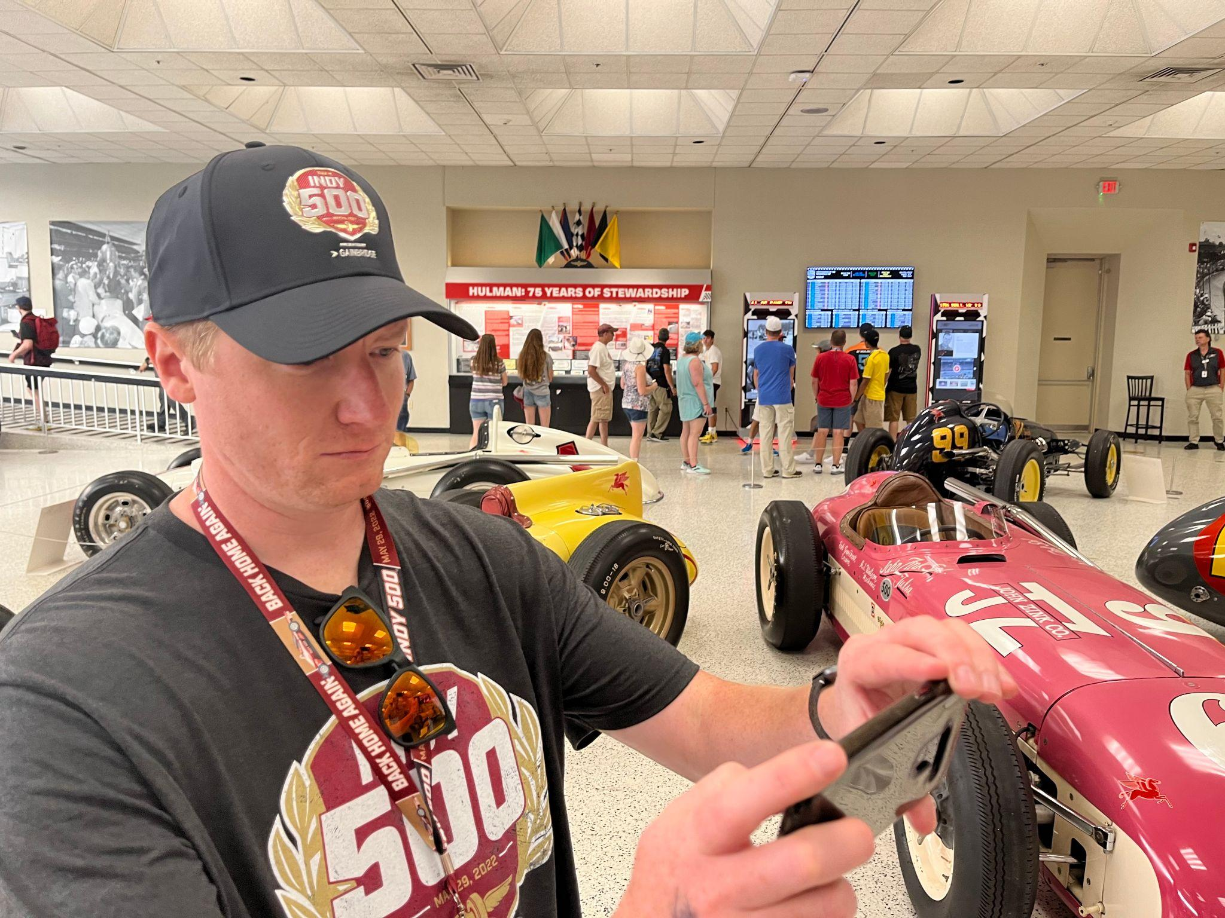
Hello!
Sean Sanders
I am here because I love to give technology presentations.

Slide 2
Objectives/Learning Outcomes

Slide 3
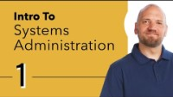

Slide 4
What is system administration?

Slide 5
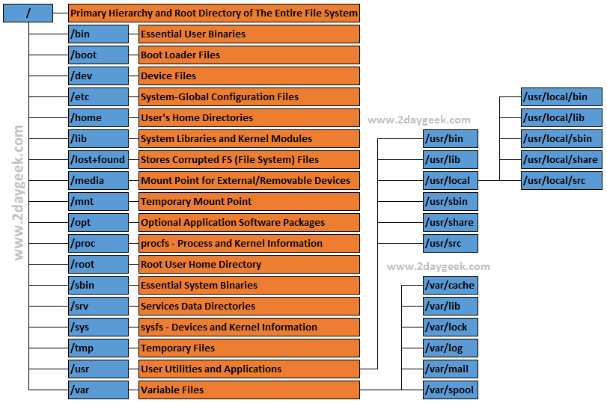

Slide 6
Login to your device
Steps:
Login to: https://cdr-vcenter.cse.buffalo.edu/
Use the credentials in the back of your name tags to login.

Slide 7
Activity 1

Slide 8
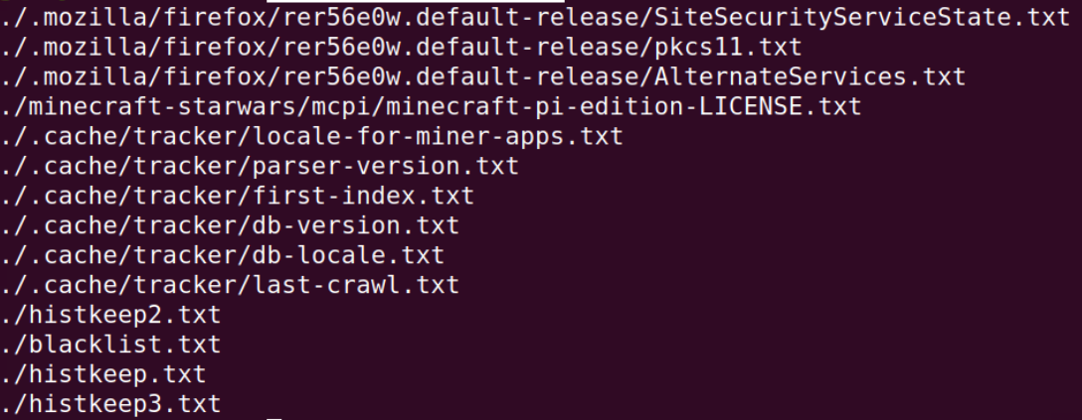
Try to find out file locations without using the change directory and ls commands
find . -name '*.txt'

Slide 9
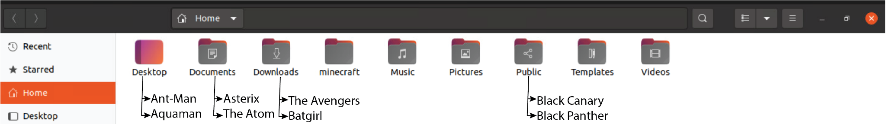
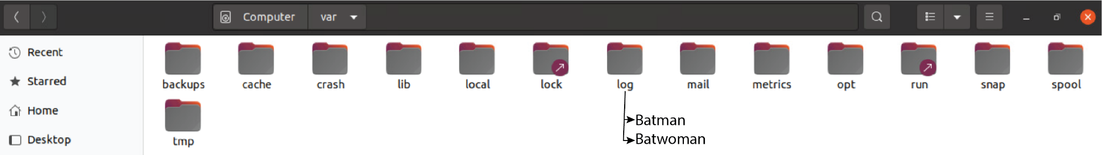

Slide 10


Slide 11
More advanced commands
Vim
highly configurable text editor built to make creating and changing any kind of text very efficient
find
Allows the searching for specific files and file names.
List of 20 advanced commands
https://www.tecmint.com/20-advanced-commands-for-linux-experts/

